Slide 1
Energy From Nuclear
Fission and Fusion
Mech 3rd yr

Slide 2
Context of the Presentation
The Problem
  While Electricity Generated from Nuclear Power (primarily Nuclear Fission for the foreseeable future) is a Very Viable Alternative Source of Energy, We in the United States Seem to Have a Very Serious Attitude Problem
      Major Effects
      Possible Causes
The Question
  What must be done to make nuclear power a significant option for meeting increasing global demand for electricity while reducing greenhouse gas emissions?

Slide 3
Presentation Outline
Electricity Generated From Nuclear Fission
  Current Status and Performance (U.S. and Foreign)
    Commercial Power Reactors
    Naval Reactors
  Overview of Current Plans for Further Development of Reactors
    Alternative Reactor Designs and Fuel Cycles
    Availability of Fuel Resources
  Key “Problem” Issues and Current Status
    Safety • Economics
    Waste Management • Proliferation Concerns
Forecasts of Useful Power from Nuclear Fusion
  Overall Fusion History and Description of the ITER Program
  Assessment of Future Prospects
Conclusions and Recommendations

Slide 4
Worldwide Nuclear Power
Provides 20% of the world’s electricity
Provides 7% of world’s total energy usage
Cost is currently similar to fossil fuels
Nuclear reactors have zero emissions of smog or CO2
There are 440 nuclear power reactors in 31 countries
30 more are under construction
They produce a total of 351 billion watts of electricity

Slide 5
World Nuclear Power Generation
(in 2000)
Country No. Reactors Generation, kWh % Total
United States 103 754 20
France 59 395 76
Japan 53 305 34
United Kingdom 35 78 22
Germany 19 160 31
Russia 29 120 15
So. Korea 16 103 41
Canada 14 69 12
India 14 14 3
Sweden 11 55 39
21 Others
Totals: 437 2,447 16

Slide 6
Current Power Reactor Types
Reactor Type Moderator Coolant Comments
Gas Cooled Reactor Graphite L. Water CO2 Coolant. Heat Exchangers
(GCR or AGC) Primarily Built in UK
Pressurized Water Reactor L. Water L. Water >50% Reactors in 24 Countries
(PWR) Water Pressure = 2000 psi
Boiling Water Reactor L. Water L. Water 2nd most common, >10% of World
(BWR) Water Pressure = 1000 psi
Canadian Deuterium U. H. Water H.water Uses natural U fuel (<1% U235)
(CANDU) Can refuel while operating. Canada
+ a few foreign sales
Chernobyl Type Graphite L. Water Infamous. 2% enriched fuel. Still
(RBMK) 11 in Russia and 2 in Lithuania
Fast Breeder Reactor na L. Sodium Complex. Produces more Pu239
(FBR) than U235 used. Expensive. Fear

Slide 7
California Nuclear Energy
Each 1,100 megawatt reactor can power one million homes.
Each reactor’s output is equivalent to 15 million barrels of oil or 3.5 million tons of coal a year.
The total 5,500 megawatts of nuclear power is out of a peak state electrical power of 30,000 – 40,000 megawatts.
The PUC is now faced with a decision to approve $1.4 billion to replace steam generators in San Onofre and Diablo Canyon.
The replacements would save consumers up to $3 billion they would have to pay for electricity elsewhere.

Slide 8
Naval Reactors
U.S. Navy
  Has about 104 reactors used as primary propulsion and electric power generation in submarines, aircraft carriers, a cruiser and a destroyer.
  Has safely accumulated over 5400 reactor-years of operation
  Since USS Natilus got underway on nuclear power in 1955, our Navy has safely steamed 130 million miles on nuc. Power
  Uses more enriched fuel than commercial reactors
  Source of trained personnel in reactor operation.
Foreign Navies
  Russia, France, United Kingdom and China. Approx. quantities are: Russia ~100; France ~20; UK ~20; and China ~ 6.

Slide 9
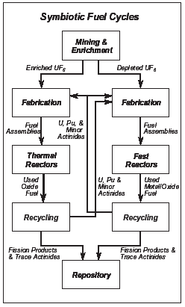

Slide 10
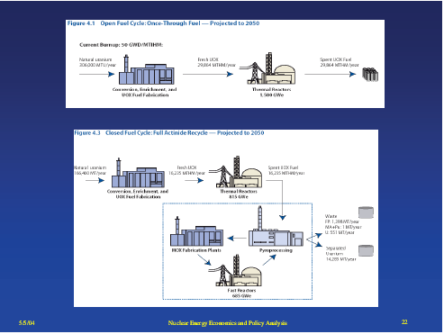

Slide 11
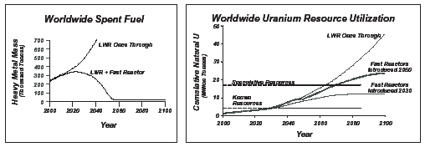

Slide 12
Soviet Nuclear Weapons to
US Reactor Fuel
We are buying highly enriched uranium (20% ²³⁵U) from the former Soviet Union’s nuclear weapons. The delivery is over 20 years from 1993—2013.
We are converting it to low enriched uranium (3% ²³⁵U) for reactor fuel. It will satisfy 9 years of US reactor fuel demand.
It comes from 6,855 Soviet nuclear warheads.

Slide 13
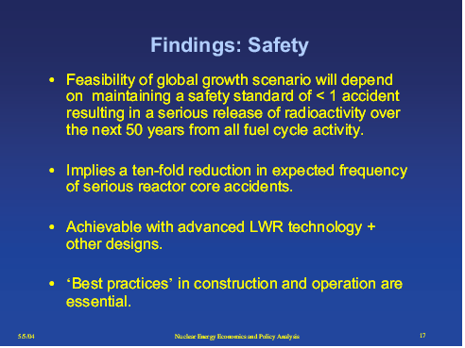

Slide 14
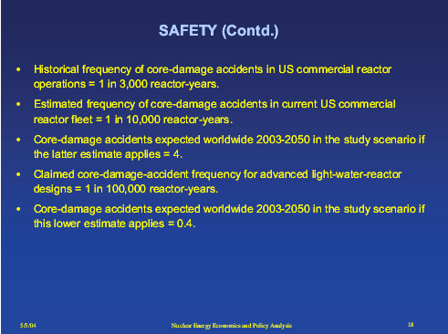

Slide 15
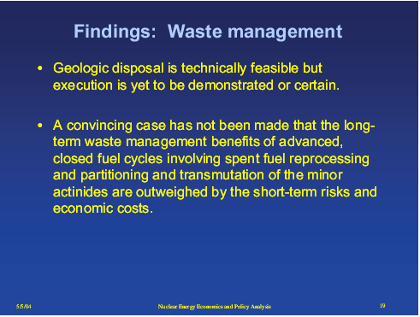

Slide 16
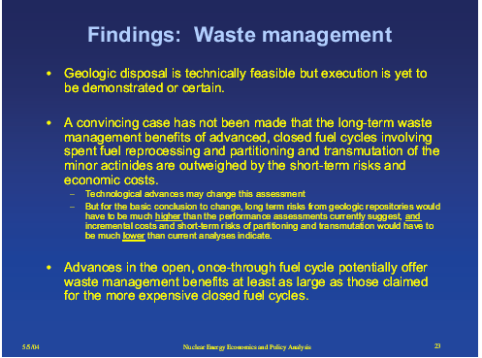

Slide 17
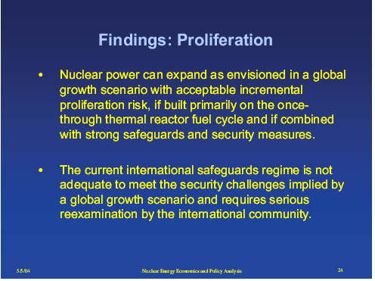

Slide 18
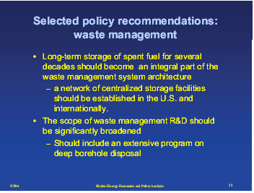

Slide 19
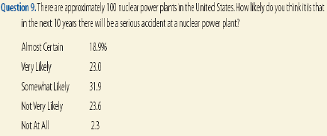
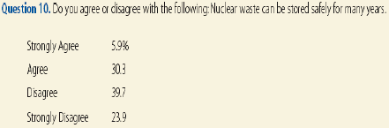
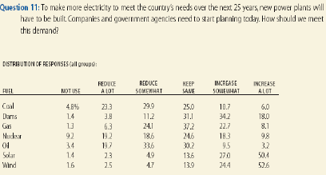

Slide 20
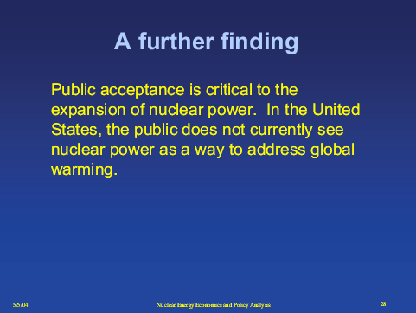

Slide 21
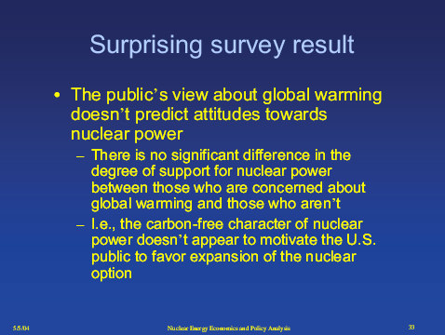

Slide 22
Nuclear Power Proposed Solution?
Richard Garwin , MIT and industry propose:
If 50 years from now the world uses twice as much energy, and half comes from nuclear power, Need 4,000 nuclear reactors, using about a million tons of Uranium a year
With higher cost terrestrial ore, would last for 300 years
Breeder reactors creating Plutonium could extend the supply to 200,000 years
Nonpolluting, non-CO2 producing source
Need more trained nuclear engineers and sites, and
Study of fuel reprocessing, waste disposal, and safety

Slide 23
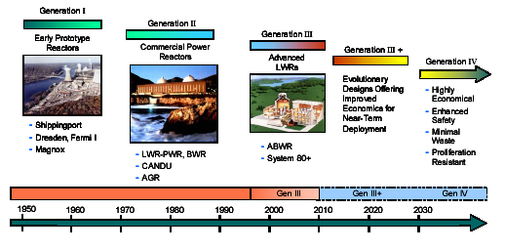

Slide 24
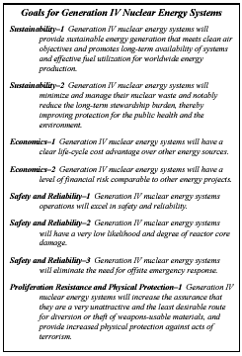

Slide 25
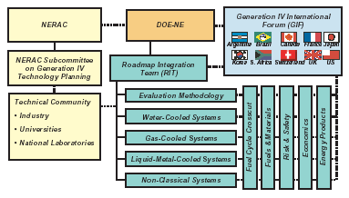

Slide 26
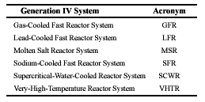

Slide 27
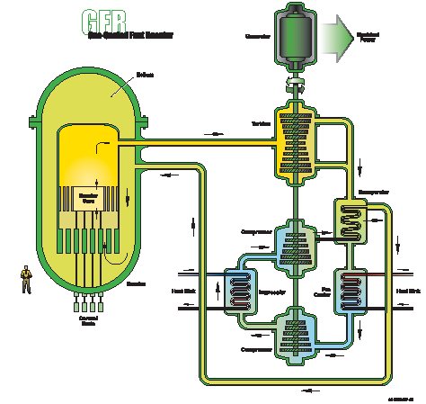
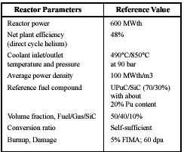
Gas-Cooled Fast Reactor

Slide 28
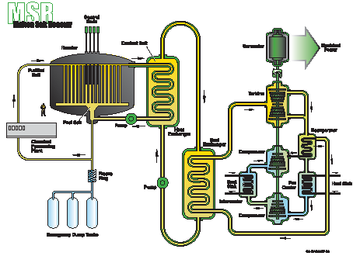
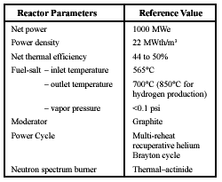
Molten Salt Reactor

Slide 29
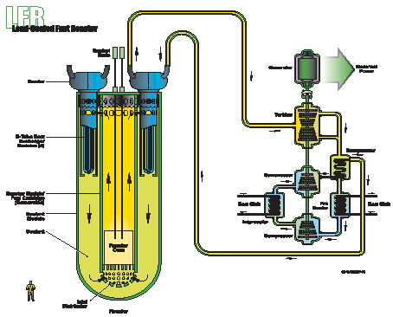
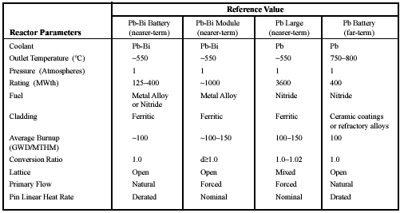
Lead-Cooled
Fast Reactor

Slide 30
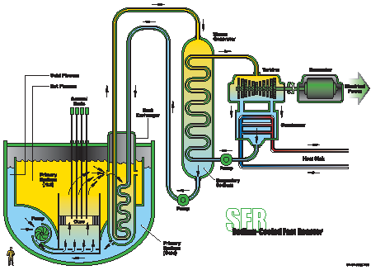
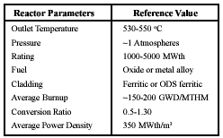
Sodium-Cooled Fast Reactor

Slide 31
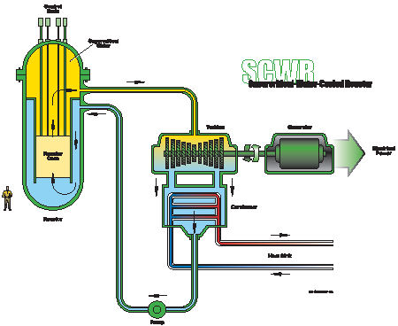
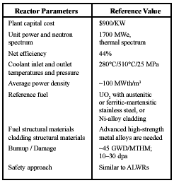
Supercritical-Water-Cooled Reactor

Slide 32
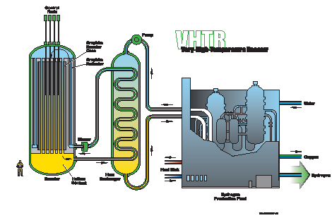
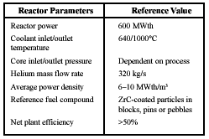
Very-High-Temperature Reactor

Slide 33
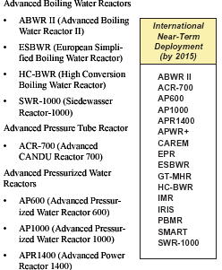
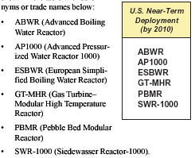
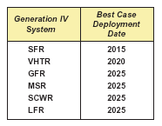

Slide 34
Southern California Edison Project
Southern California Edison Project
Controversial Issues
  A. San Diego Gas and Electric
  B. Anaheim Public Utilities
  C. Anti Nuclear Activists
PUC hearing 17 May 2005, Oceanside, CA
Decision Process
  A. Evidence Presented to Administrative Law Judge
  B. Commission Prepares Decision
  C. Parties Petition for Rehearing
Decision

Slide 35
Fusion Power Technology-ITER
ITER = International Thermonuclear Experimental Reactor
A Joint Project Conducted by:
  European Union Russian Federation
  United States Canada Japan
The Purposes of ITER are:
  Demo that electrical power from fusion is scientifically and technically feasible
  Utilize results of a robust R&D Program
  Build and Initially test the Demo System
  Estimated to cost >$4.5 billion over 10 years
Based on a “Tokamak” Design. 10 Years were Required to accomplish the reactor Design
Results of Practical Electric Power from ITER are Probably 10-20 years away

Slide 36
Fusion Reactors
Fusion easiest for Deuterium on Tritium
in a high temperature plasma.
Replacement Tritium created from a Lithium blanket around the reactor absorbing a produced neutron.
Fusion reactors
International ITER in 2012 for research for a decade, costing $5 billion
Current stalemate over siting in France or Japan
To be followed by DEMO for a functioning plant, taking another 10 years. So not ready for building units until at least 2030.
DEMO will cost $50 billion for a similar capacity as a nuclear reactor.
US Lithium supply would last a few hundred years.
Still would be a radioactive waste disposal problem.

Slide 37
